Slide 1
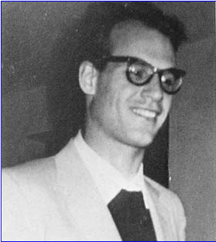
Alexander Grothendieck: The Man
Mathematics requires a small dose, not of genius, but of an imaginative freedom which, in a larger dose, would be insanity. And if mathematicians tend to burn out early in their careers, it is probably because life has forced them to acquire too much common sense, thereby rendering them too sane to work. But by then they are sane enough to teach, so a use can still be found for them.
--Angus K. Rodgers
Abdullah Naeem Malik Mphil 3rd QAU

Slide 2
Disclaimer

Slide 3
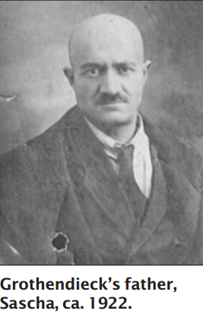
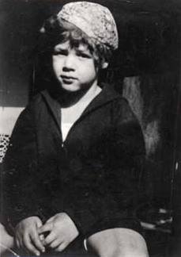
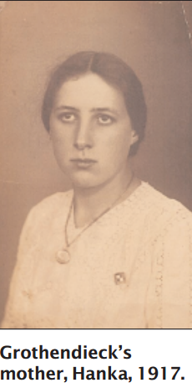
Biographical Highlight
Born 28 March 1928 in Berlin
Father: Alexander "Sascha" Schapiro
Met Hanka Grothendieck in 1927

Slide 4
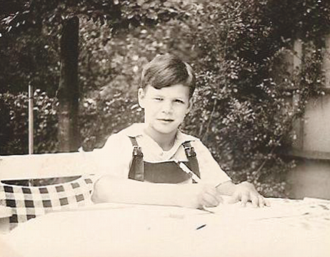
Biographical Highlight
Lived with parents + Maidi first five years
Moved to Hamburg in 1933; tutored by a Pastor, ex-army officer Wilhelm Heydon
Moved to Paris in 1939
World War II
Moved to Montpellier in 1945
Paris 1948

Slide 5
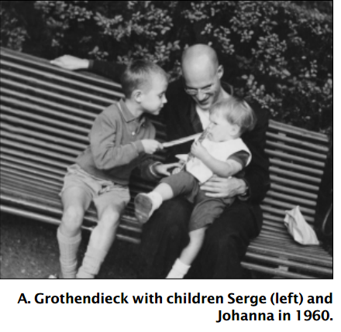
Biographical Highlight
Birth of Serge in Nancy
Relationship with son
Family ties

Slide 6
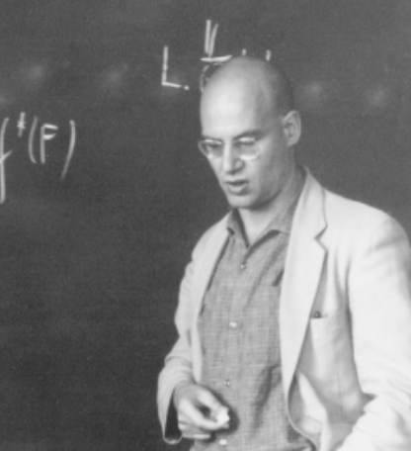
Character
Antimilitary
Stateless (Nansen passport till 1980s)
Algerian War (1954 – 1962)
Harvard Visit: Correspondence with Zariski
Employment issues + Math as a career
Student Revolution May 1968
Resignation from IHES in 1970
Vietnam War (1955 – 1975)
Pacifist (1970 Survival Group and failure) + ecologist
1970 ICM Nice
Plagiarism

Slide 7
Character (cotd.)
Simple life
Rejection of Crafoord Prize + Fields Medal
Bursts of Generosity
Charismatic but brash
Charles Ehresmann at Bourbaki Serminar 1949
Visit of Arthur Wightman to IHES
Strained relations with colleagues and students

Slide 8
Rejection of Crafoord Prize: Letter
(1) My professor's salary, combined with my pension beginning in October, is, by far, more than enough for my needs and for those to whom I am responsible. In other words, I don't need the money. As for the esteem accorded to certain research that I've done on the fundamentals of mathematics, it is my strong conviction that the only decisive test of the viability of an idea, or of a new vision of the world, is that of time. The fertility of an idea is to be judged by the quality of its offspring, and not through honors.

Slide 9
Rejection of Crafoord Prize: Letter
(2) In addition I've observed that those research workers at high levels to whom prizes like the Crafoord Prize are given, have already attained to such a level of eminence in society, that they have more than they need of material benefits and prestige among their colleagues, as well as the authority and perks that accompany these things. Is it not obvious, however, that these excessive rewards to the few must come at the expense of the many?

Slide 10
Rejection of Crafoord Prize: Letter
(2) (sic. A misprint) Those labors which now earn me the approbation of the Royal Academy were carried out 25 years ago, at a time when I was still integrated into the scientific milieu and shared both its worldview and its values. But I departed from this milieu in 1970. Since then, while not in the least renouncing my passion for scientific research, I have continued to put some distance between myself and scientific circles.

Slide 11
Rejection of Crafoord Prize: Letter
In the two decades that have intervened the ethical standards of the sciences (certainly in mathematics) have been degraded to such an extent that the most bare-faced plagiarism between colleagues (often at the expense of those who can't defend themselves), seems to have become the norm. At least it is generally tolerated, even in exceptionally flagrant instances.
Given this situation, were I to agree to enter into the game of prizes and rewards, it would be equivalent to my giving stamp of approval to a state of affairs in today's sciences that I see as being profoundly unhealthy. Their spiritual state, even their intellectual and material states, are nothing less than suicidal, hence they are destined to vanish in the near future.
It is this third reason which, for me, is the most compelling. If I've gone out of my way to make an issue of it, you should not thereby conclude that I intend any criticism of the Royal Academy, or in its administration of the funds under its command.
I firmly believe that we can expect totally unprecedented upheavals before the end of the century which will transform, from top to bottom, our very notion of what is called "science", or its objectives, and the spirit in which it is done. I am certain that the Royal Academy will be among those institutions, and individuals, who will have useful roles to play in a revival without historical precedent, after a total destruction of civilization also without historical precedent.

Slide 12
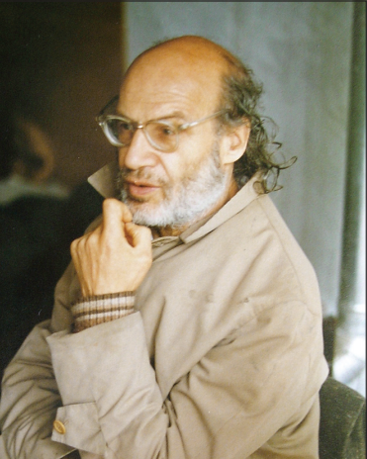
Religion
Buddhism (1974)
Christianity (1980)
Delusions
Hermit life (1991)
Death on November 13, 2014 last heard “raging about the devil”

Slide 13
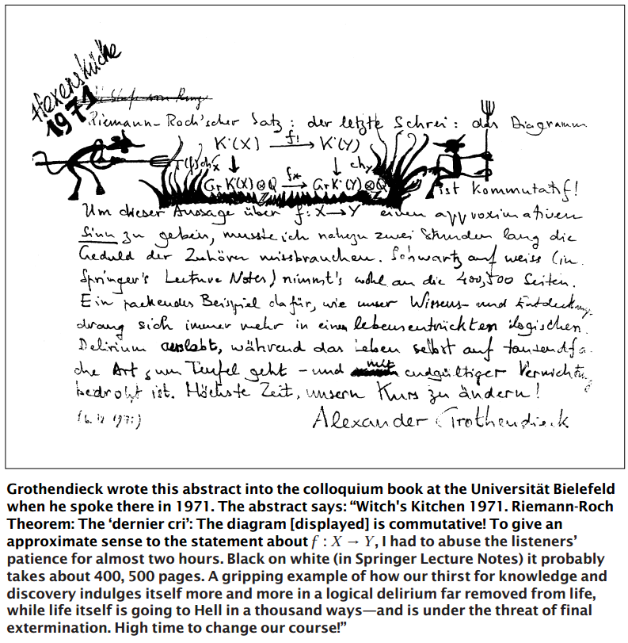

Slide 14
